Slide 1
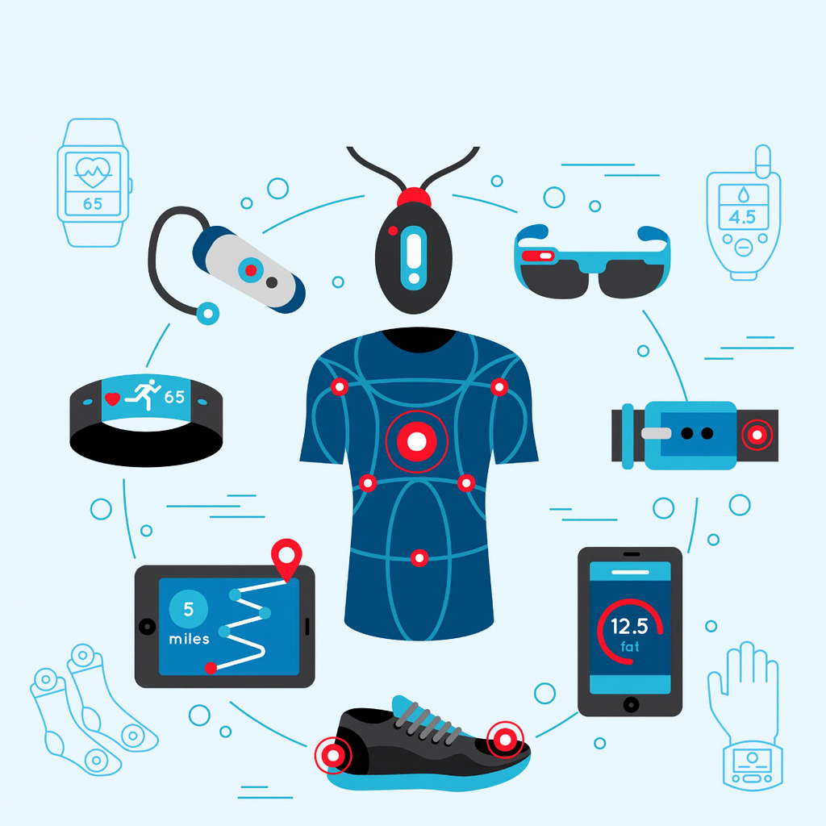
Compromised by Design
The Hidden Risks of Wearables
Notes:
Choices have consequences. And sometimes, the consequences don’t hit us until much later. Wearable smart devices are a choice. Insightful. Motivational. Convenient. And sometimes, life-saving.
Wearables are not just gadgets on us — they’re extensions of us, and the data they stream touches our security, our safety, and our privacy.
This presentation is not about hacking smart watches, it’s an examination of three things —
what biological data wearables collect,
then we’ll follow that stream into the real-world risks, and
finish with how we stay in control

Slide 2
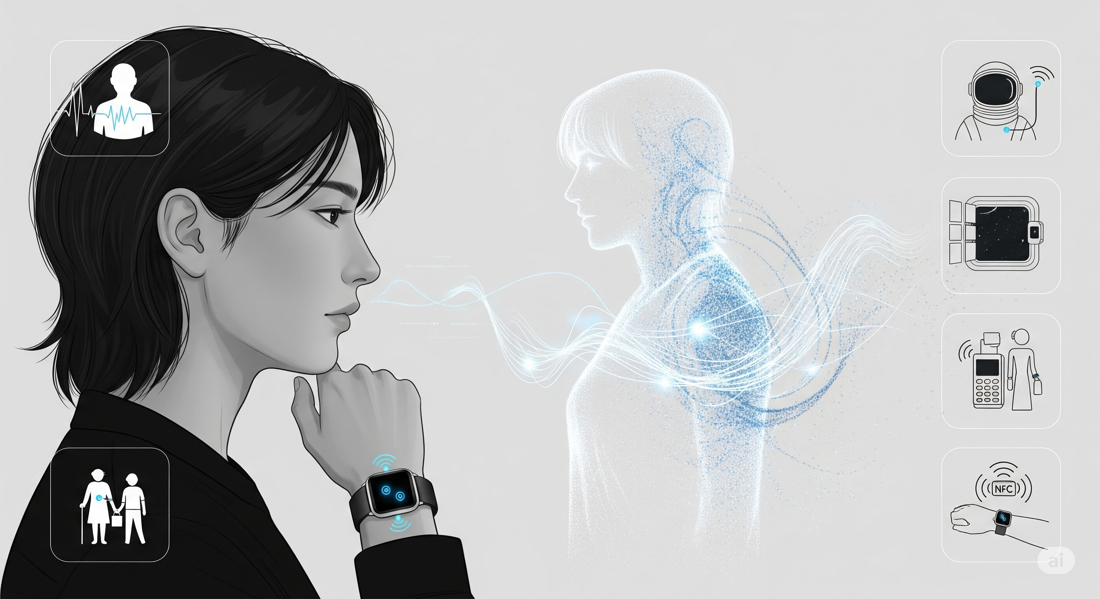
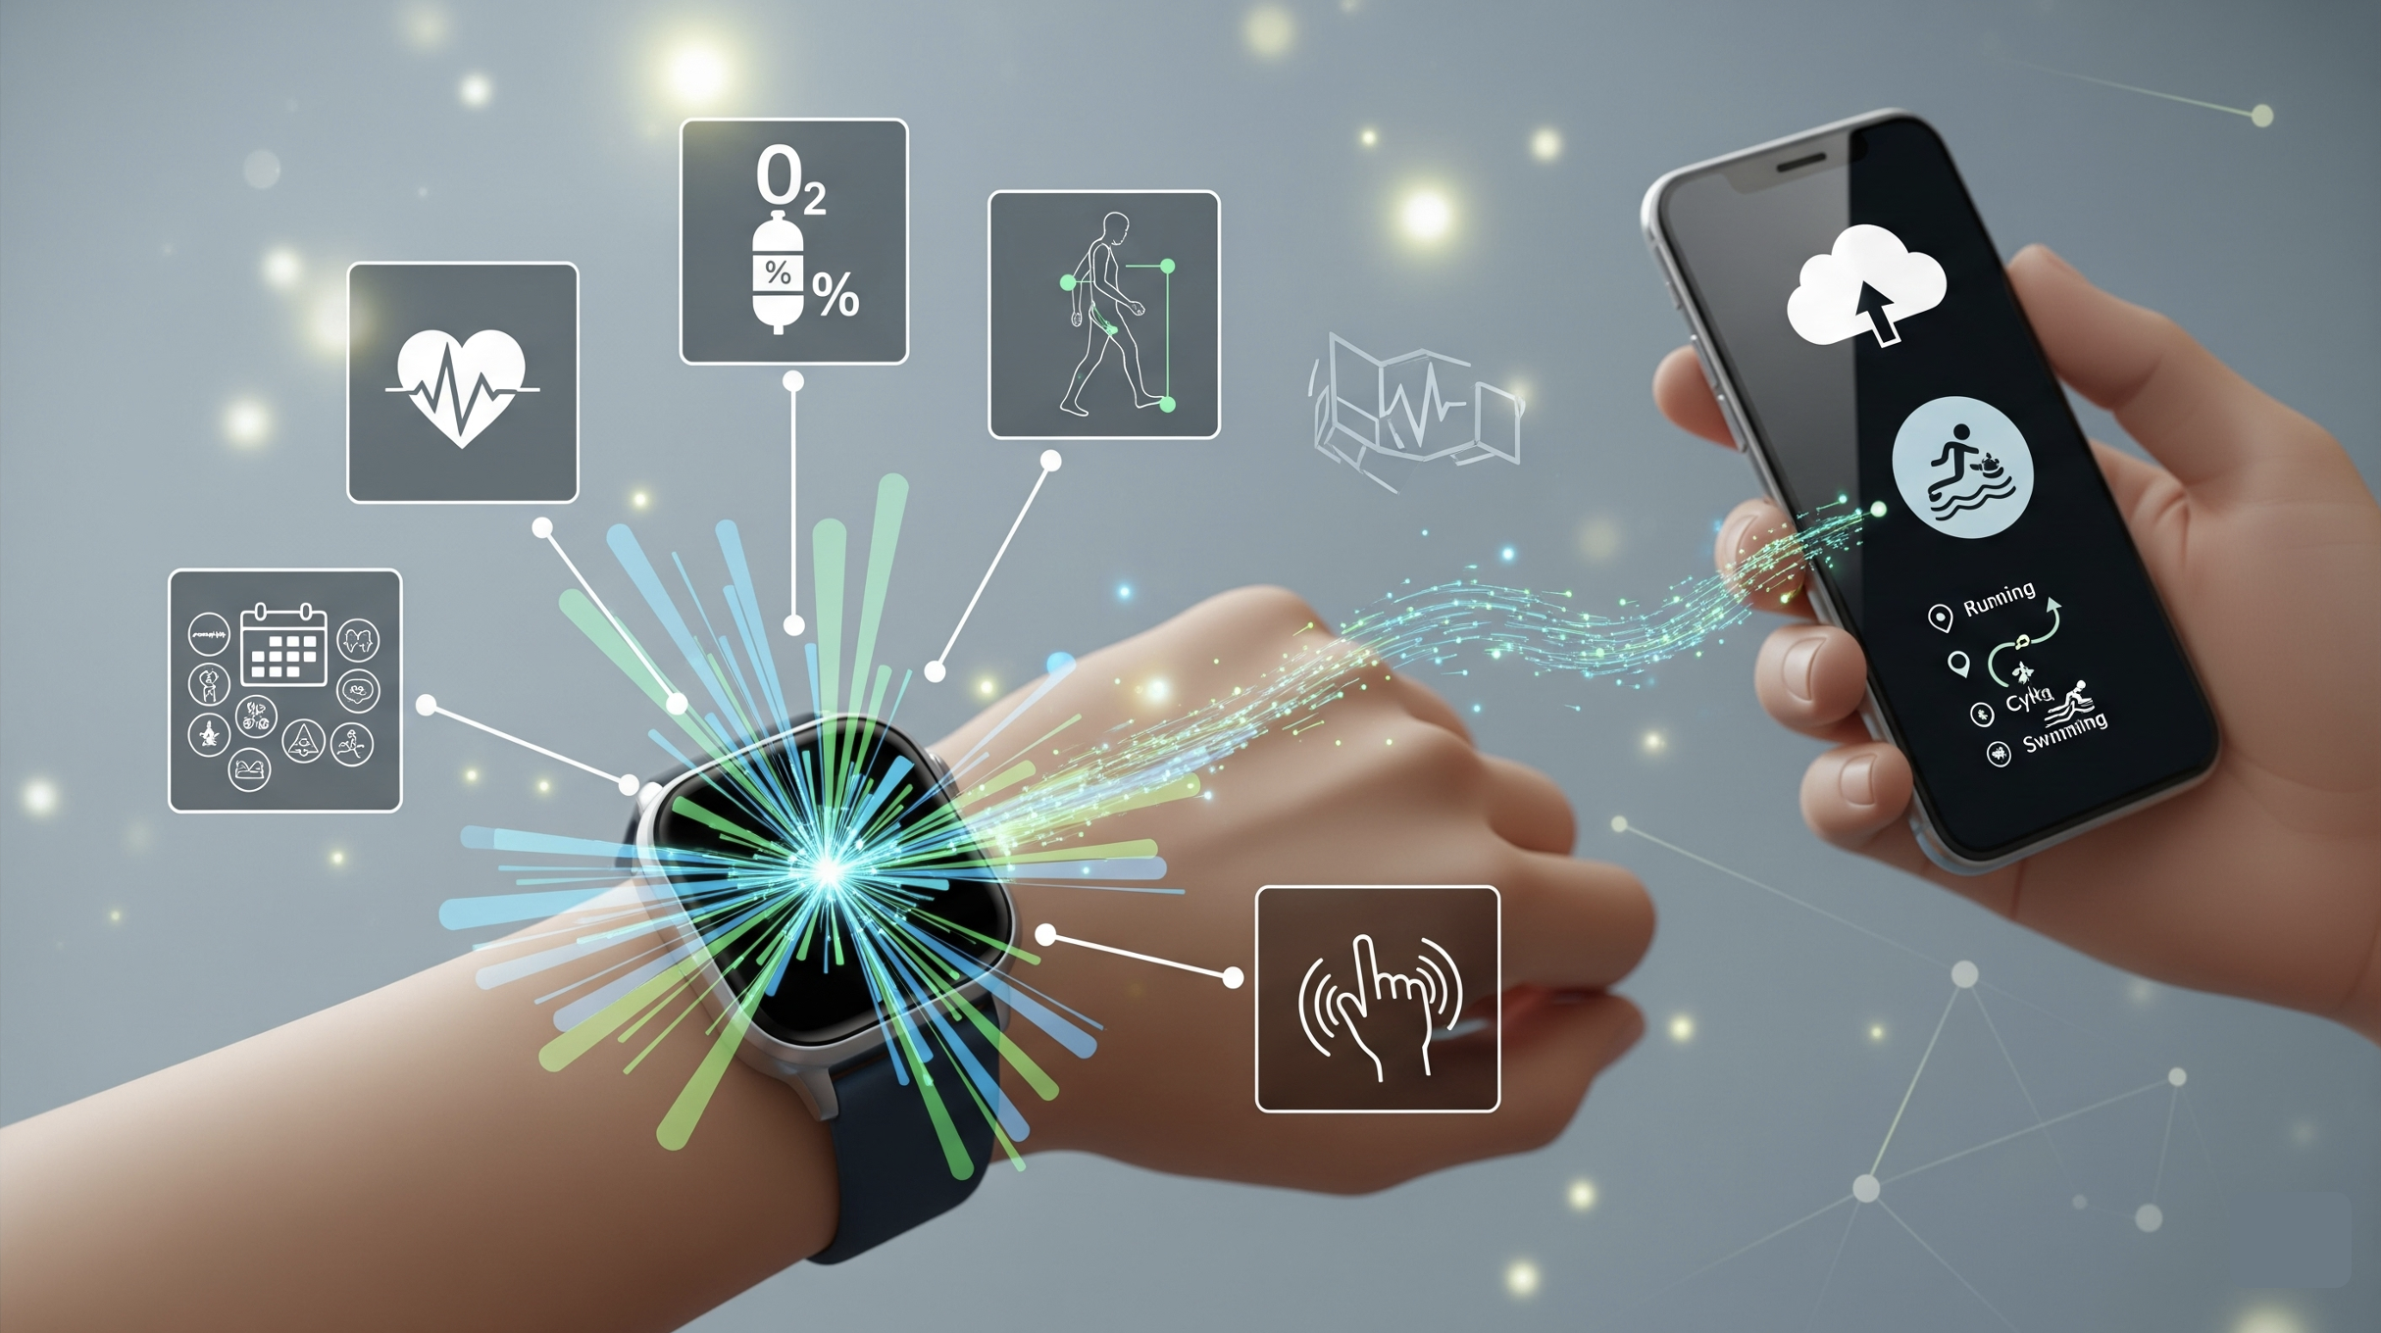
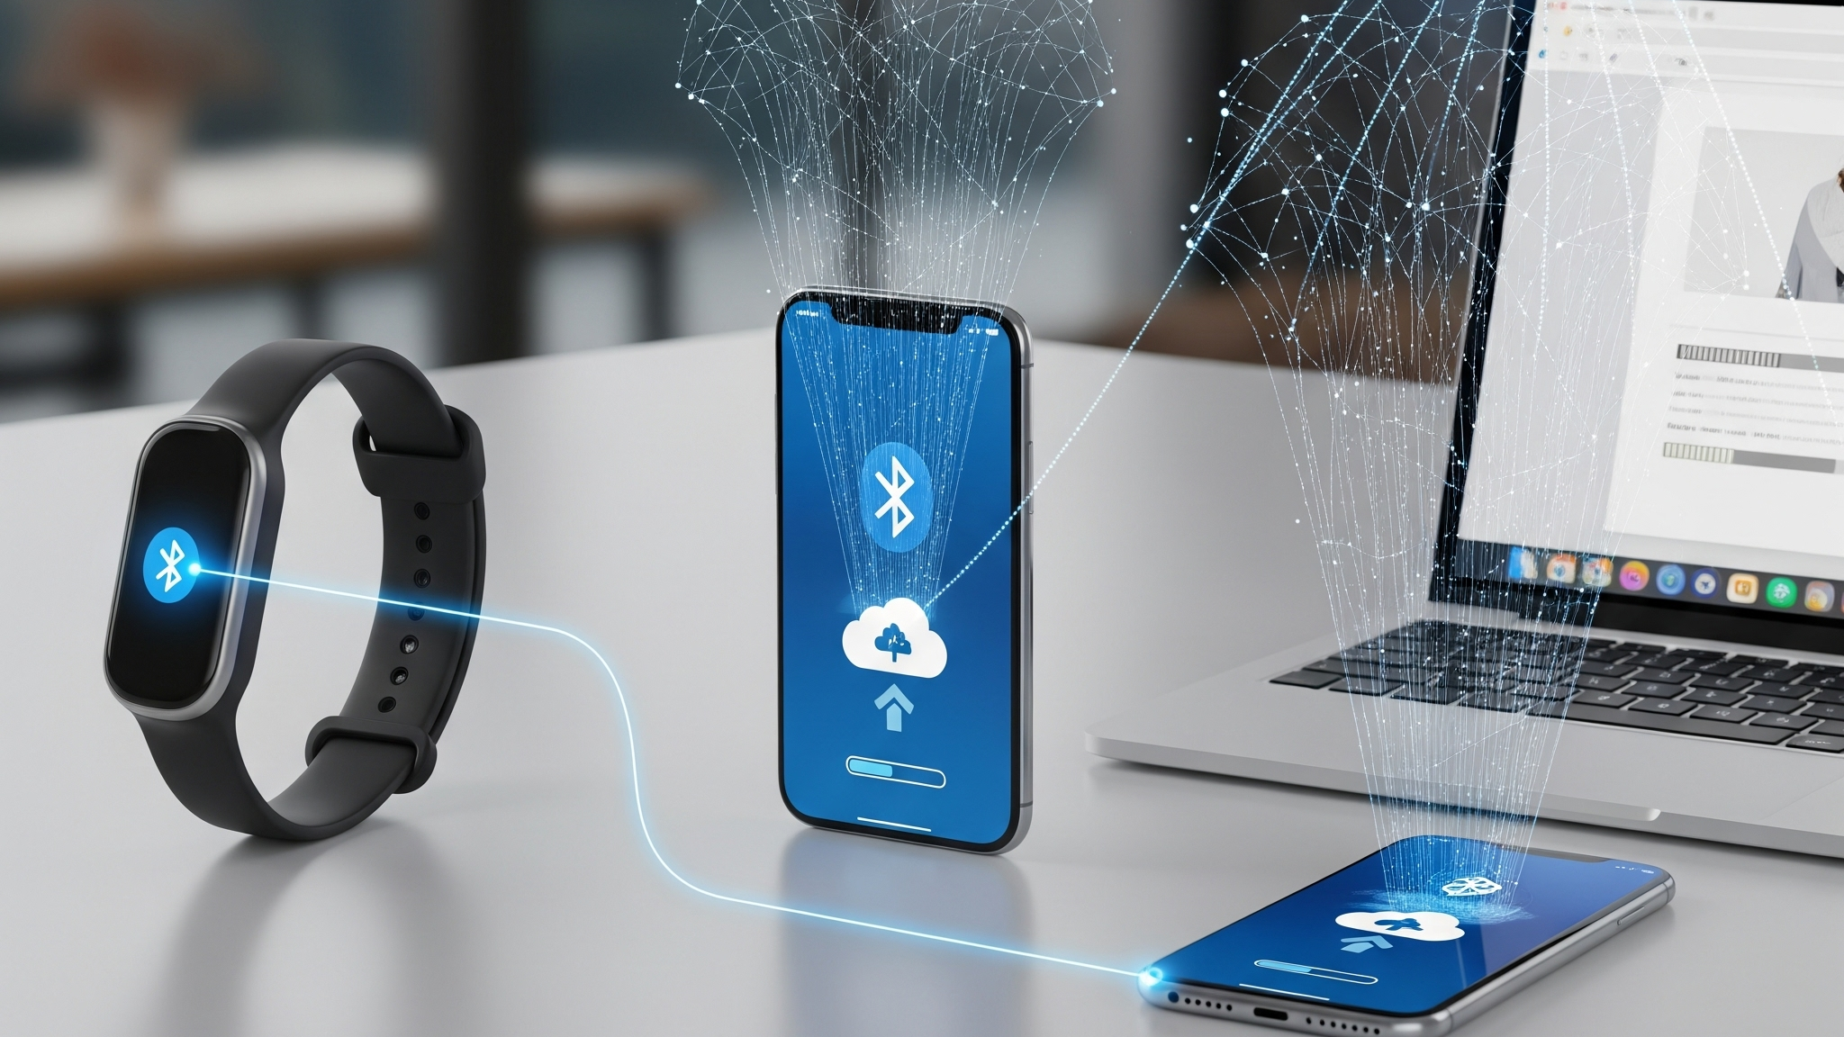
Data Wearables Collect
Biological Digital Twin
Notes:
Modern wearables don’t just count steps or calories. They track Heart-rate changes, oxygen levels, shifts in how we walk, menstrual cycles, tremors, GPS trails, and signals from the environment.
Piece by piece, the wearables build a real-time digital twin of our body, feelings, behaviour, and our whereabouts. The digital twin remains in sync with our physical reality every second we wear a smart device.
In health, clinical, disability, aged care, and space exploration settings, a real-time biological digital twin is immensely helpful. Continuous monitoring can spot emerging conditions before we feel them. In some cases, it saves lives.
In retail, wearable devices speed up payments and, when paired with biometrics, they can reduce payment scams and frauds.
If we pause and look at the diversity and enormity of our personal, biological, and physical wellbeing and weaknesses these devices and their makers collect and share with a large number of third parties and Governments across the world – the privacy and safety risks start to dawn upon us.

Slide 3
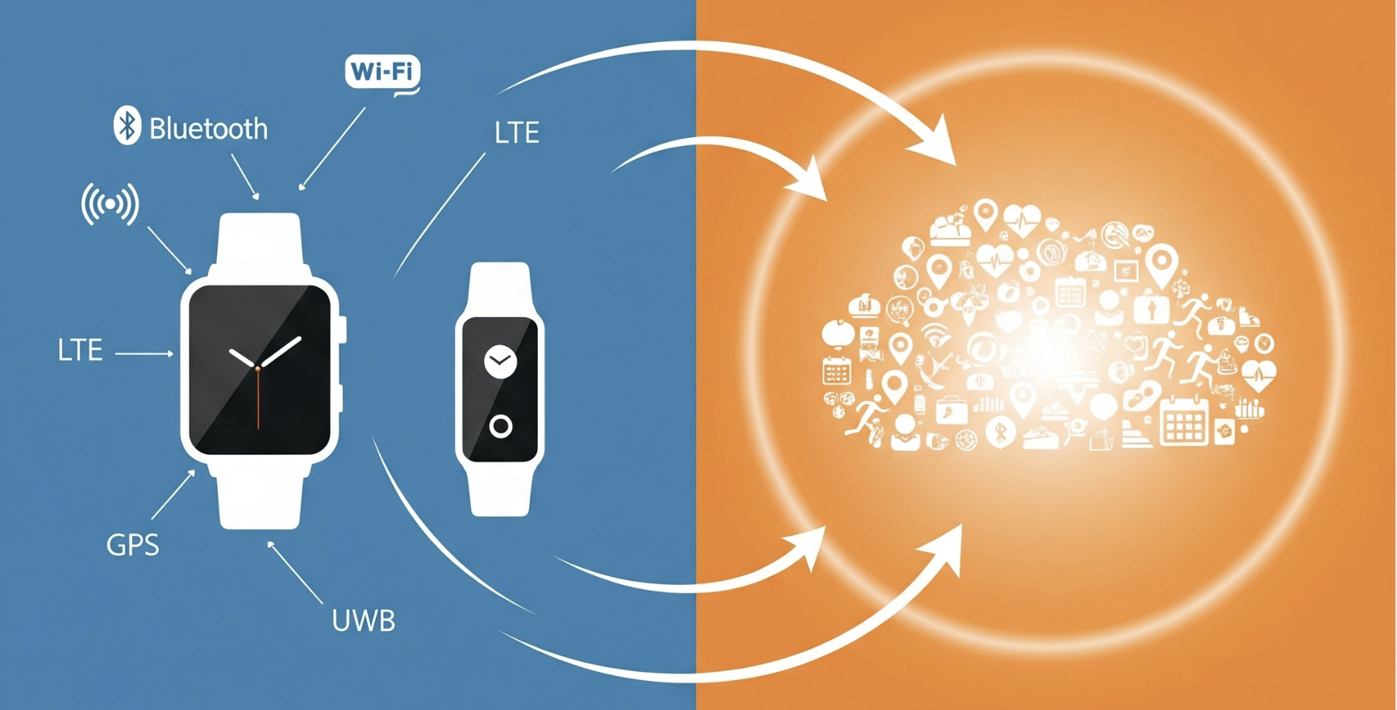
Risks
Notes:
The answer to the obvious question - “Can our wearable be hacked? - for most reputable devices — Apple, Fitbit, Samsung, clinical wearables — is: not easily and doing so is not a good return on investment for malicious actors.
This is because the hardware from most reputed manufacturers such as Fitbit, Apple, Samsung, and medical wearable makers is robust, with operating system and firmware patched regularly. MFA helps with access control. Transmission over Bluetooth, Wi-Fi, or 5G is encrypted.
The device, device manufacturers, and transmission are not where the real risks are. The tangible risks are associated with the centralisation of our biological data. The ecosystem of third-party integrations values continuous access to our biological and location data over our privacy and safety.
I would like to invite you to look at the centralised treasure troves of millions of people’s personal, biological, mental, and physical information through the lens of malicious individual and state actors.

Slide 4
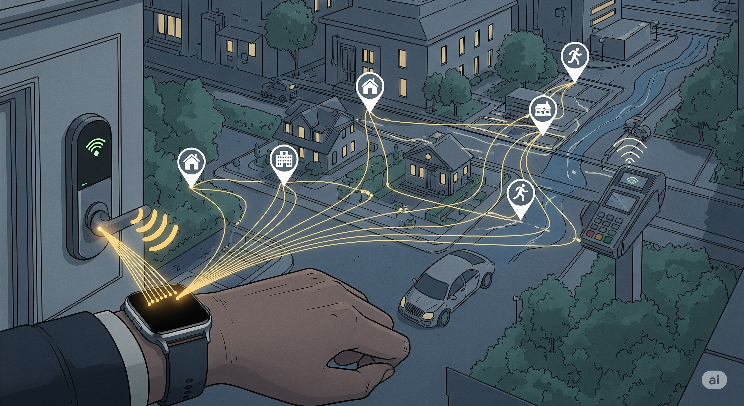
Physical Safety and Access
Notes:
Look at the picture and think about our week. Our wearables draw the same lines — home, work, school, childcare, run, defence bases, data centres, etc.
If someone wants to create a real-time and accurate map of us, our loved ones, and what tangibly matters to us as individuals and the nation, this is the playbook.
Shared health and location data can become tools for stalking and coercive control in domestic abuse cases.
Stolen or spoofed signals from our devices can be relayed to a unlock a door, a car, or a payment reader.

Slide 5
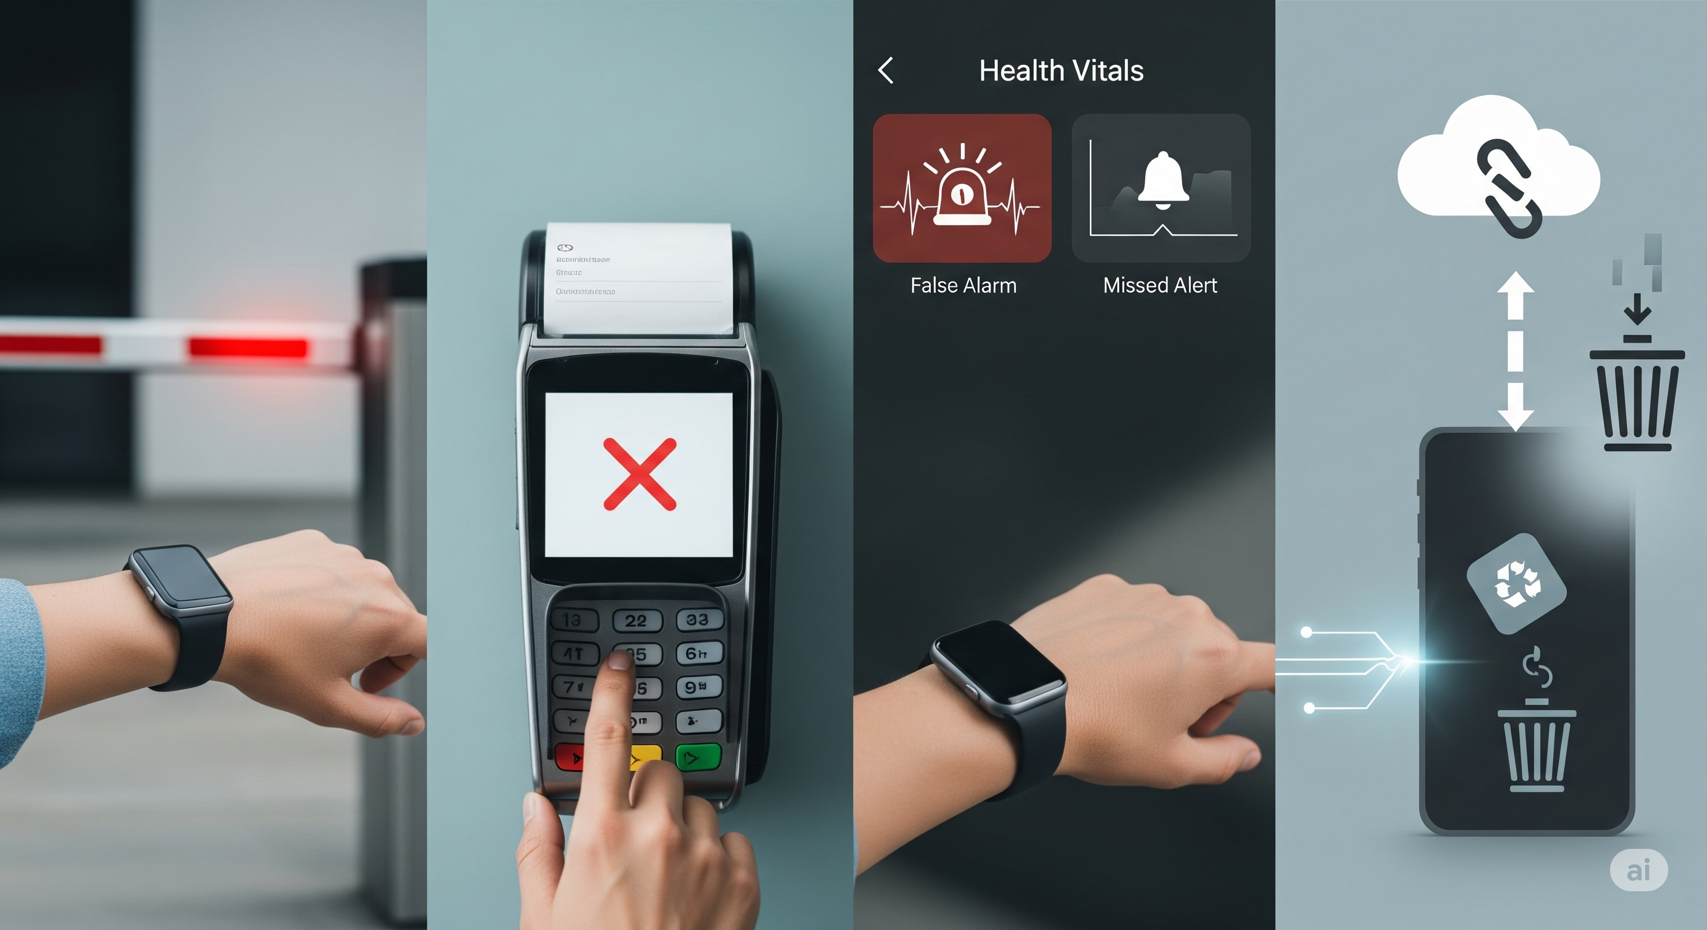
Account Takeover
Notes:
A compromised third party’s database can lead to a takeover of our accounts connected with our wearables, and this account takeover can compromise our safety in the real world.
This can strand us at a gate, block payments, or silence critical alerts right when we need them. Sensor spoofing or replay can trigger false medical alarms — or worse, suppress real ones — and we make bad decisions off bad data.

Slide 6
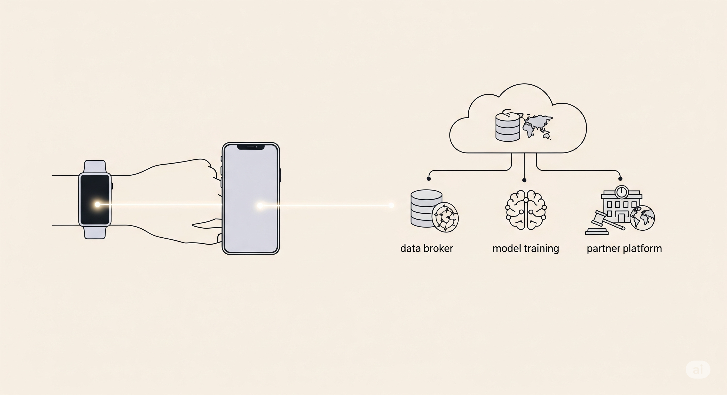
Profiling and Exposure
Notes:
Once our data leaves the device, it keeps working — just not for us.
Data from wellness apps flow into insurance broker files and become a shadow profile which can be used to determine eligibility for certain insurance covers.
Receipts, Wi-Fi logs, and ad IDs can stitch anonymous and de-identified data back to us and in aggregation, can uniquely identify and expose us for profiling purposes.
Data models train on our traces and assign scores that follow us around. In courts, at a border, or after a merger, years of our personal, health, location, biometric, and financial data can change hands without our consent because we accepted the T&Cs all those years ago.

Slide 7
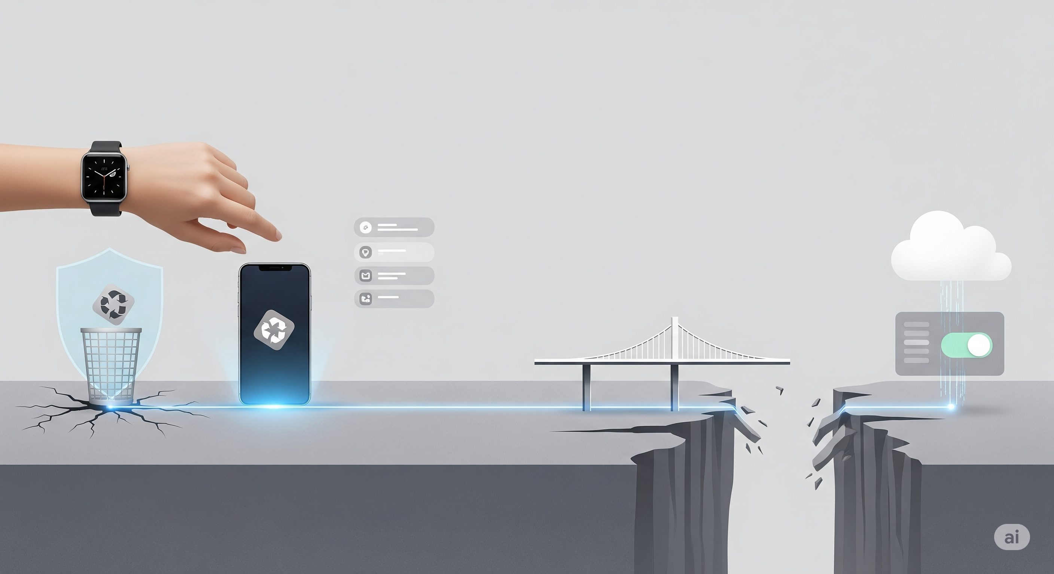
Perception vs Reality
Notes:
Part of the gap is perception versus reality.
We believe deleting a third-party mobile app stops the data sync from our wearables. In reality, the data keeps syncing unless we revoke access at the source device such as our Fitbit or Apple watch. Consent fatigue means most of us click allow or accept either without thinking or without fully understanding the risks and consequences.
To be clear, most third parties do not have malicious intention – it’s not personal, it’s purely business… and our real-time continuous biological data is what keeps the business profitable.
Our control exists — but it’s hidden, inconvenient, or time-limited. Businesses get acquired, sometimes by foreign entities that do not have to abide by the laws of where their consumers live. Our data may get mixed up in legal investigations spanning global jurisdictions – thereby exposing us to state actors whose interests may be misaligned with ours.
Over time, the gap between what we believe is happening and what’s actually happening gets wider… until it’s too late to close or undo.

Slide 8
KCD Framework
Know
Control
Decide
Notes:
Now that we have a fulsome understanding of the data wearables collect and the risks we are exposed to, let’s dive into how we strike a balance between usability and safety.
For those managing chronic illness, recovering from surgery, or caring for older relatives, wearables are essential. For the rest of us, whether we can opt out or not, awareness and control still matter.
The KCD framework is simple:
Know means we create a map of what data is collected, where it flows, how long it’s retained, and how we can have it permanently deleted.
Control means we turn on passkeys or MFA and we remove unsafe or unnecessary integrations and syncs at the source wearable device and in the phone’s health app.
Decide means if there’s no source-level revocation, no clear end-of-life policy, or unnamed partners, or partners in unfriendly countries, we don’t use such devices.

Slide 9
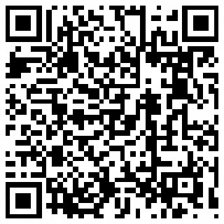
THANK YOU
Gaurav Vikash
Don’t use what we can’t understand or control.
Notes:
We can’t be casual with a living dataset that reaches into our access, our safety, and our legal life. We choose what to connect, and we choose the price we’re willing to pay.
We must not use devices what we can’t know or control. That’s how we keep the benefits while paying the minimum price.

Slide 10
Know | Learn the data flow from the device, all the way to vendor cloud and its partners, and potential risks along the way. Verify security basics - hardware security, connection security, passkeys or MFA options, transparent release notes, update cadence, breach history, data storage location, privacy policy, etc. Dependency on the device and connectivity: Does the device work offline, and can we switch devices without losing history if we lose or damage the device?
Control | Lock access first — enable passkeys or MFA, unique email alias per account, disable social logins, do not pair in public places Minimise inputs — turn off sensors and data types we don’t need, remove background location, limit Bluetooth advertising, disable microphone access unless required Govern connections — link only the essentials, review third-party integrations quarterly Plan for degraded mode — mirror critical alerts to SMS, keep a physical key for doors and cars that rely on presence, carry a fallback payment card
Decide | Apply hard lines - If we cannot stop a data sync with a third-party app, we won’t purchase the device. If the device maker shares our data with unnamed or overseas partners, we won’t purchase the device Conduct regular review: quick monthly glance at connections, deep quarterly audit of permissions, integrations, exports, and retention
Notes:
Detailed KCD

